Slide 1
ST10032544
PROG6212 Final POE

Slide 2
Contract Monthly Claim System

Slide 3
Contents
Home Page/Submit Page
Verify Page
Approve Page
Track Page

Slide 4
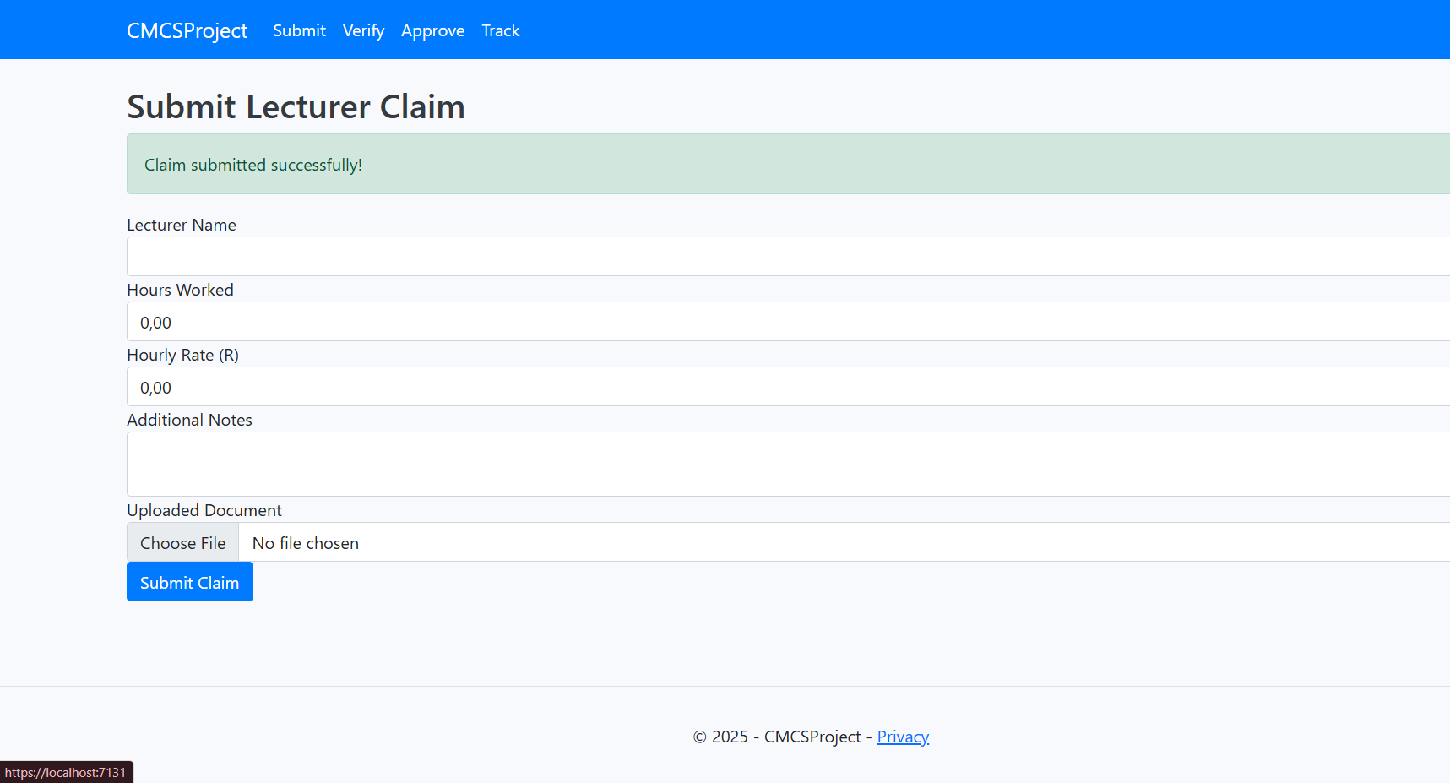
Submit Page
The submission page.
This is the page where the lecturers submit their claims and seen with the image provide on the right. Its is a very simple process as you enter your details and each provided block has to the be filled in with the proper information requested. If that is not done the page will notify you as you have an incomplete area. Thus, not allowing you to proceed. Once your claim is submitted successfully you will then receive a notification telling you that the claim has been completed successfully.

Slide 5
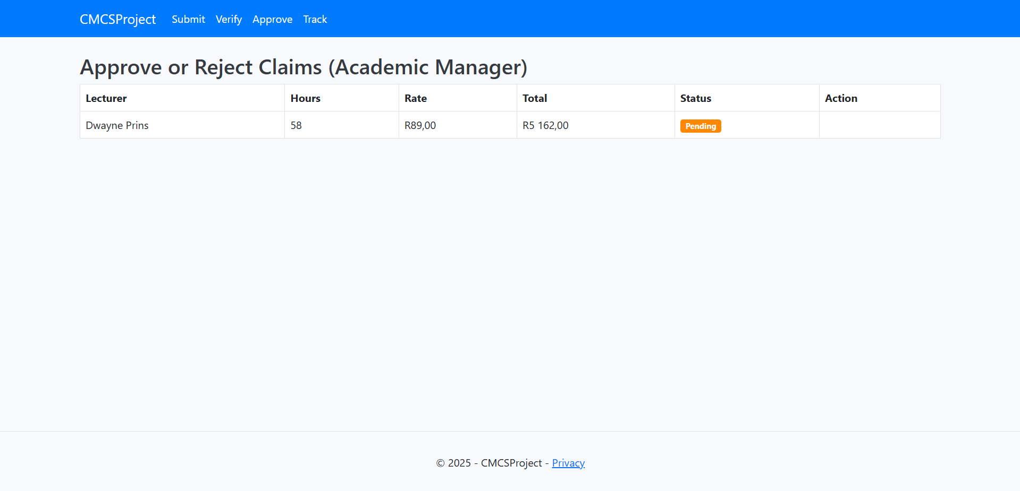
Approve and Reject Page
The Approve Page
This is the decision-making hub. After verification, the academic manager or HR team uses this page to approve or reject claims. It’s where final judgments happen. Approved claims move on to processing and eventual payment, while rejected claims are sent back with feedback. This page keeps the process smooth, organized, and accountable, ensuring that no claim is lost or overlooked.

Slide 6
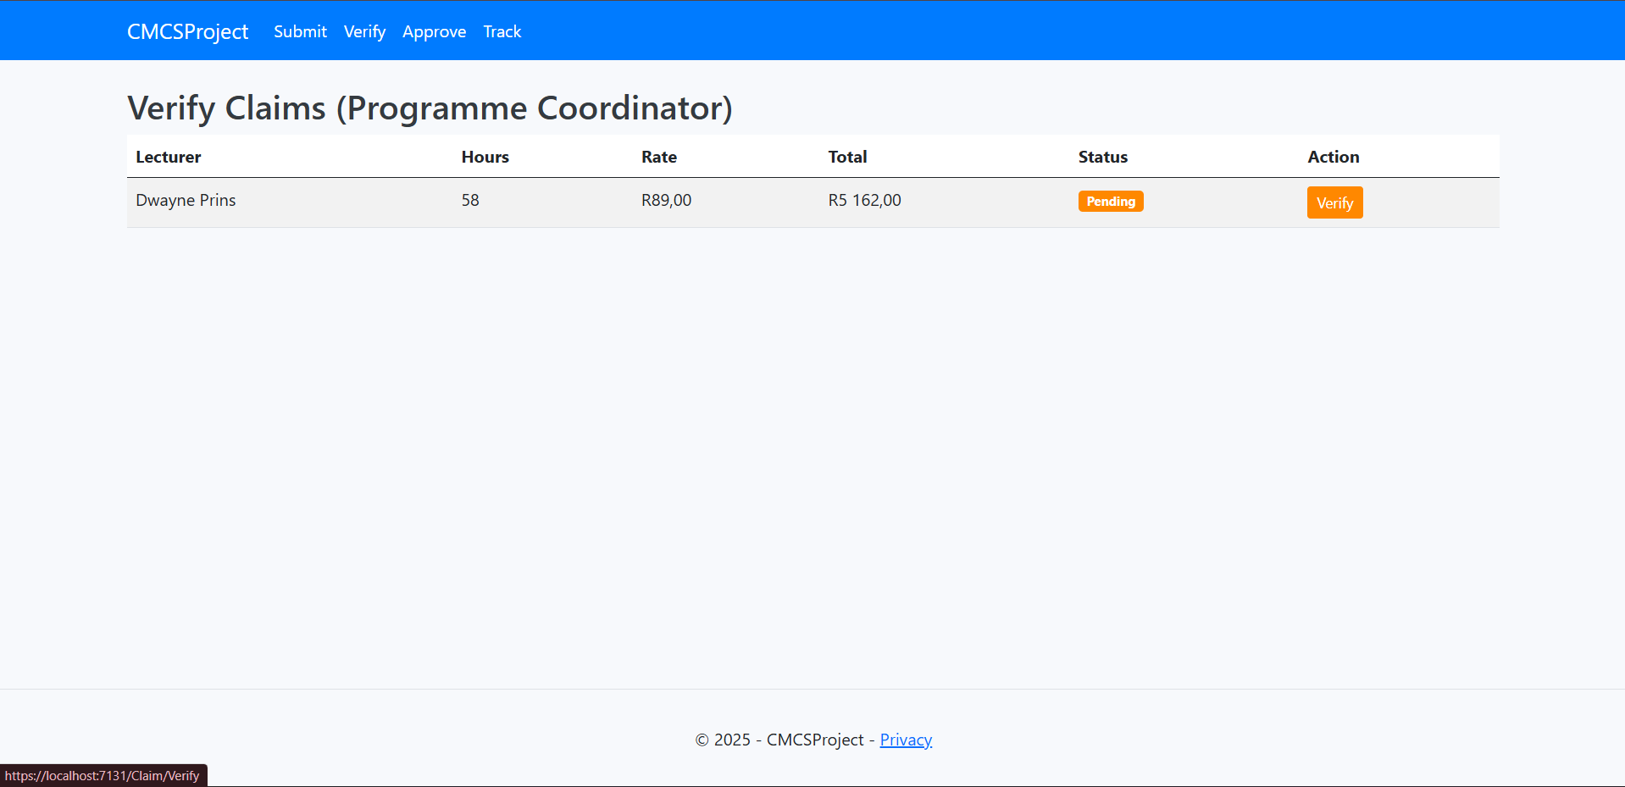
Verify Page
The Verify Page
This is the workspace of the coordinator or academic manager. This is where they review claims that have been submitted. This allows for them to properly assess the documents and information provided before verifying or rejecting the claims.

Slide 7
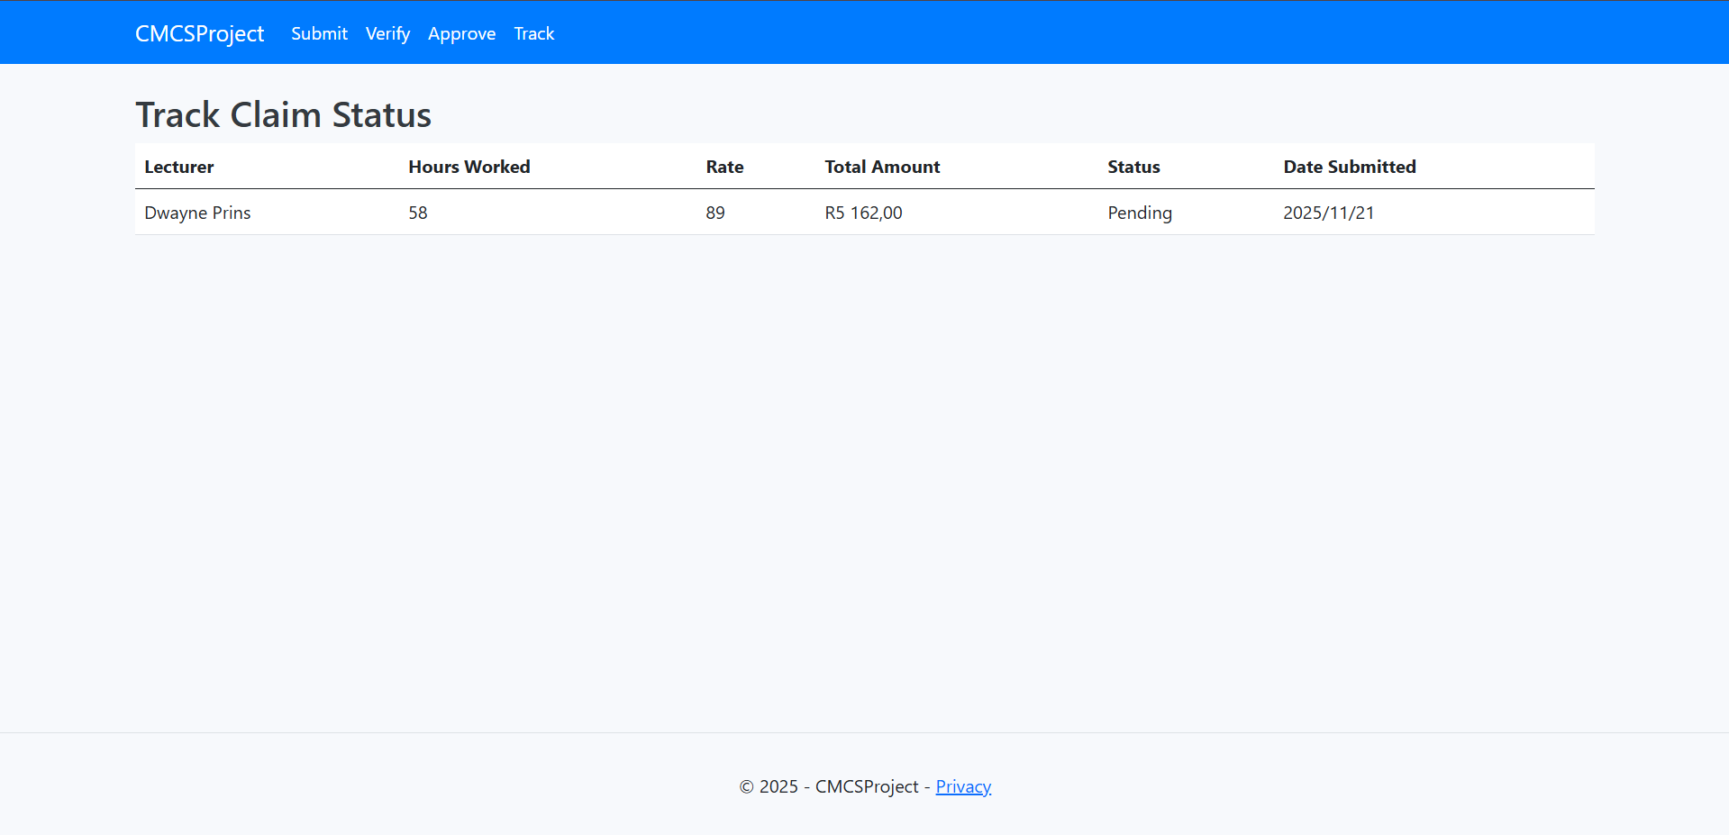
Track Page
The Track Page.
This is the page that provides the lecturer with the details on the status of the claim. Whether it is verified, rejected or still pending. Providing them with transparency and reassurance.

